Slide 1
Employee Attribution Analysis Using Excel Dashboards
STUDENT NAME: Pavithra.B
REGISTER NO: 312209433
NM ID : 462926896676677879C4C5587C5D3D8B
DEPARTMENT: B.Com A&F
COLLEGE: Anna Adarsh College for Women

Slide 2
PROJECT TITLE
Employee Attribution Analysis Using Excel Dashboards

Slide 3


AGENDA
Problem Statement
Project Overview
End Users
Our Solution and Proposition
Dataset Description
Modelling Approach
Results and Discussion
Conclusion
3/21/2024 Annual Review

Slide 4

PROBLEM STATEMENT
Develop an Excel dashboard to analyse employee attribution, focusing on key metrics like turnover rates, reasons for leaving and departmental trends. The goal is to identify patterns and provide actionable insights for improving employee retention strategies.

Slide 5

PROJECT OVERVIEW
.
This project contains the information about the employee performance which includes Employee ID, Name, Department, Education field, Gender, Hourly rate, Job role, Martial status, Monthly income, Over time, Total working years, Years at company.

Slide 6

WHO ARE THE END USERS?
HR teams
Managers
Employee
Employer
Organizations
Organizational leaders

Slide 7

OUR SOLUTION AND ITS VALUE PROPOSITION
Conditional formatting : It highlights cells based on criteria, automatically applying formatting like colors or fonts to visualize data trends and patterns. For eg : Highlighting the each department with the different colours.
Pivot table : It summarizes and analyses the large sets by organizing and grouping data into a customizable table for easier insights. For eg: Summarizes the 1000 employee database into a customizable table for easy purpose.
Slicer : It filters the data in pivot tables or tables , allowing for easy and intuitive data analysis by selecting specific criteria. For eg : Filtering the gender and department of the employee for easy analysis.

Slide 8
Dataset Description
Employee ID : A unique identifier assigned to each employee
Name: The name of the employee
Department : The department or the role the employee works in, encoded into categories such as Research and Development, Sales and Human Resource
Educational field : The educational field the employee belongs to, encoded into categories such as Life Sciences, Medical, Marketing, Technical Degree, Human Resource and other
Gender : The gender of the employee
Hourly Rate: The price that we charge per hour for a work
Job role : A formal definition of an employee’s role within an organization that outlines their responsibilities , duties and expectations

Slide 9
Dataset Description
Martial Status: The martial status of the employee (Single, Married, Divorced)
Monthly Income: The monthly salary of the employee, in rupees
Over time: It is the additional hours worked beyond a standard workweek, typically 40 hours. It often comes with extra pay, usually at a higher rate than regular hours
Total Working Years : The sum of all the years a person has been employed or has been actively working in their career
Years at Company: The number of years the employee has been working at the company

Slide 10

THE "WOW" IN OUR SOLUTION
Created a slicer particularly for
Name
Gender
Department
Job Role
Over Time Years at Company
3/21/2024 Annual Review
10

Slide 11
MODELLING
Creating a Employee dataset Creating a data using the MS Excel :
Create a data of the employee data which includes Employee ID, Name, Department, Educational field, Gender, Hourly rate, Job role, Martial status, Monthly Income, Overtime, Total working years, Years at Company
Applying Conditional Formatting in Dataset :
1. Highlight the department range of cells where you want to apply conditional formatting
Go to the HOME tab on the Ribbon
Click on Conditional Formatting in the Styles group
Click on Highlight Cells Rules ---- Text that contains ---- Sales (yellow colour fill)
Click OK to apply the rule
2. Highlight the Educational Field range of cells where you want to apply conditional formatting
Go to the HOME tab on the Ribbon
Click on Conditional Formatting in the Styles group
Click on Highlight Cells Rules ---- Text that contains ---- Education field (yellow colour fill)
Click OK to apply the rule
11

Slide 12
MODELLING
2. Highlight the Educational Field range of cells where you want to apply conditional formatting
Go to the HOME tab on the Ribbon
Click on Conditional Formatting in the Styles group
Click on Highlight Cells Rules ---- Text that contains ---- Education field – Life Sciences ( blue fill ) , Medical ( Grey fill )
Click OK to apply the rule
3. Highlight the Gender range of cells where you want to apply conditional formatting
Go to the HOME tab on the Ribbon
Click on Conditional Formatting in the Styles group
Click on Highlight Cells Rules ---- Text that contains ---- Female ( Red text )
Click OK to apply the rule
4. Highlight the Hourly Rate range of cells where you want to apply conditional formatting
Go to the HOME tab on the Ribbon
Click on Conditional Formatting in the Styles group
Click on Icon Sets
Click on Color Scales to differentiate the marks
12

Slide 13
MODELLING
5. Highlight the Martial Status range of cells where you want to apply conditional formatting
Go to the HOME tab on the Ribbon
Click on Conditional Formatting in the Styles group
Click on Highlight Cells Rules---- Text that contains ------ Single ( green fill ), Divorced ( red fill )
Click OK to apply the rule
6. Highlight the Monthly Income range of cells where you want to apply conditional formatting
Go to the HOME tab on the Ribbon
Click on Conditional Formatting in the Styles group
Click on Data bar ------ Select Blue Data bar
Click OK to apply the rule
7. Highlight the Over Time range of cells where you want to apply conditional formatting
Go to the HOME tab on the Ribbon
Click on Conditional Formatting in the Styles group
Click on Highlight Cells Rules ---- Text that contains ---- No ( Red text )
Click OK to apply the rule

Slide 14
MODELLING
8. Highlight the Total Working Years range of cells where you want to apply conditional formatting
Go to the HOME tab on the Ribbon
Click on Conditional Formatting in the Styles group
Click on Highlight Cells Rules ---- Greater than > ---- > 15 (yellow colour fill)
Click OK to apply the rule
9. Highlight the Years at Company range of cells where you want to apply conditional formatting
Go to the HOME tab on the Ribbon
Click on Conditional Formatting in the Styles group
Click on Highlight Cells Rules ---- Lesser than< ---- <5 (grey color fill)
Click OK to apply the rule
Application of Pivot table to the dataset :
Highlight the range of data you want to analyse .
Go to the “ Insert” tab on the ribbon
Click “PivotTable” in the Tables group
In the Create Pivot Table dialog box, select the range and choose where you want the PivotTable to be placed ( existing worksheet )

Slide 15
MODELLING
In the PivotTable Field List pane, drag and drop fields into different areas :
Employee ID and Name : Row
Department : Columns
Hourly rate : Values ( Sums )
Application of slicer to dataset :
Select your data range
Go to the “Insert” tab and click “PivotTable”
Click on your PivotTable to activate it
Go to the “PivotTable Analyze” tab on the ribbon
Click “Insert Slicer” in the filter group
In the insert Slicers dialoge box, check the boxes for the fields you want to create slicers for.
Click “OK”
The slicer will appear on your worksheet as a separate box
Clock on the buttons within the slicer to filter data in your PivotTable. We can select multiple items such as Name, Gender, Department, Job role, Over time, Years at company by holding the Ctrl key while clicking

Slide 16
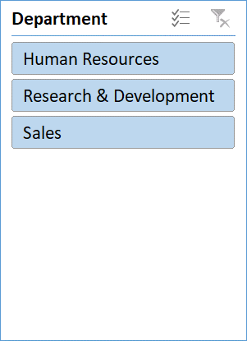
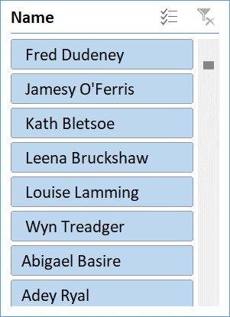
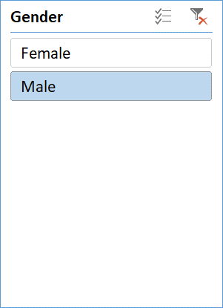
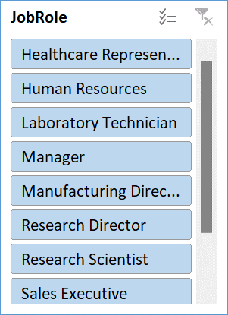
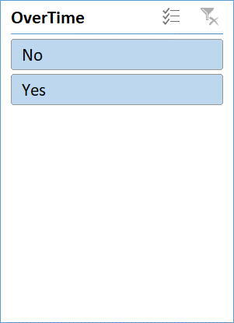
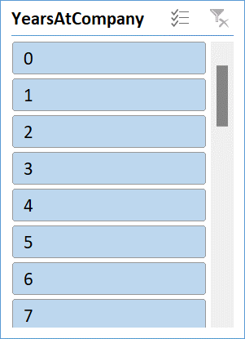
RESULTS
16

Slide 17
Conclusion
In conclusion, the Excel Dashboards for employee attribution analysis provides valuable insights into turnover trends, departmental impacts, and reasons for leaving. By presenting data in an accessible and visual format, it empowers HR teams and managers to make informed decisions, develop targeted retention strategies and ultimately enhance employee satisfaction and organizational stability.

